Slide 1
Main Title of Presentation
Sub-heading
DABE
February 28, 2020
Dallas, TX
Name of Presenter
Title of Presenter
Date

Slide 2

Who We Are - What We Do
EXIM Bank is an independent agency of the U.S. Government
  Established in 1934
  Headquartered in Washington, DC
  Twelve Regional offices
Mission: To create and sustain jobs by
increasing U.S. export sales

Slide 3
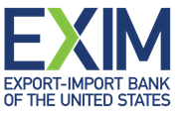
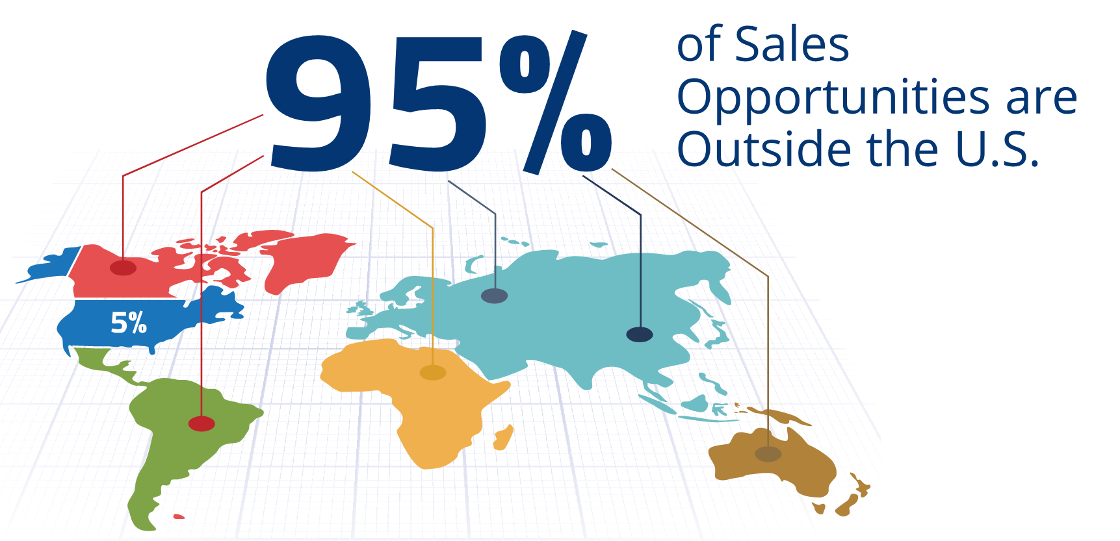

Slide 5
We Support a Variety of Industries
  Manufacturing
  Construction Equipment
  Medical Equipment
  Mining
  Power-generation
  Aircraft and Avionics
  Services
  Renewable Energy
  Agribusiness
  Wholesale/Retail
  Oil & Gas
  https://customermap.exim.gov/state_map.cfm?state=TX

Slide 6
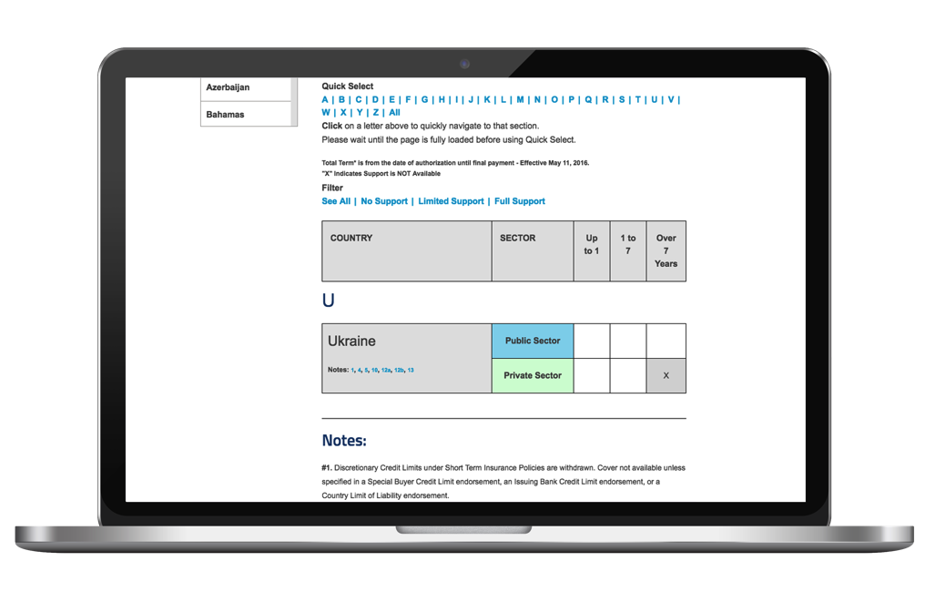
Restricted Countries
  Restrictions may apply to buyers in certain countries, for political or economic conditions
  Check the Country Limitation Schedule (‘X’ means support unavailable)
  exim.gov/tools-for-exporters/country-limitation schedule

Slide 7
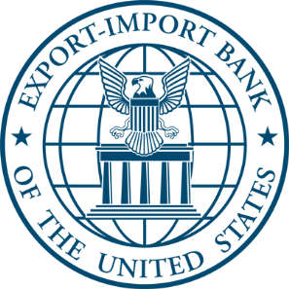

PUBLIC POLICY (CHARTER) RESTRICTIONS – Just a Few
No Military or Defense-related products or obligors
(exceptions apply)
U.S. Content (Standard-Term: 50+%; Medium-Term: 85% U.S.)
Economic impact
Shipping
Additionality
Notes:
No military or defense products except for humanitarian efforts/drug interdiction.
RESTRICTED COUNTRIES: Country Limitation Schedule (CLS) is on the website exim.gov. Before considering doing business in a country refer to the schedule to confirm if EXIM is open in a country and how long.

Slide 8
EXIM Bank Financing Covers the Spectrum
Pre-Export Financing
Post-Export Financing
Insurance
Guarantees
Direct Loans
Working Capital Guarantee

Slide 9
I. Working Capital Guarantee
90% guarantee on principal and interest
for export-related inventory and A/R
  Guarantee also covers certain
  liquidation costs
Generally one year or less
Must be fully collateralized
Covers exporter performance risk
Note: Provides no protection to exporter
against foreign buyer non-payment
Notes:
In same line of business for at least 3 years.
Have at least one year of exporting experience.
Had an operating profit in their most recent fiscal year.
Dun & Bradstreet Paydex of 50 or higher and no derogatory information.
Signed financial statements for the last fiscal year that show positive net worth.
Net Worth at the most recent fiscal year-end is at least 10% of requested policy limit.
No material adverse issues.

Slide 10
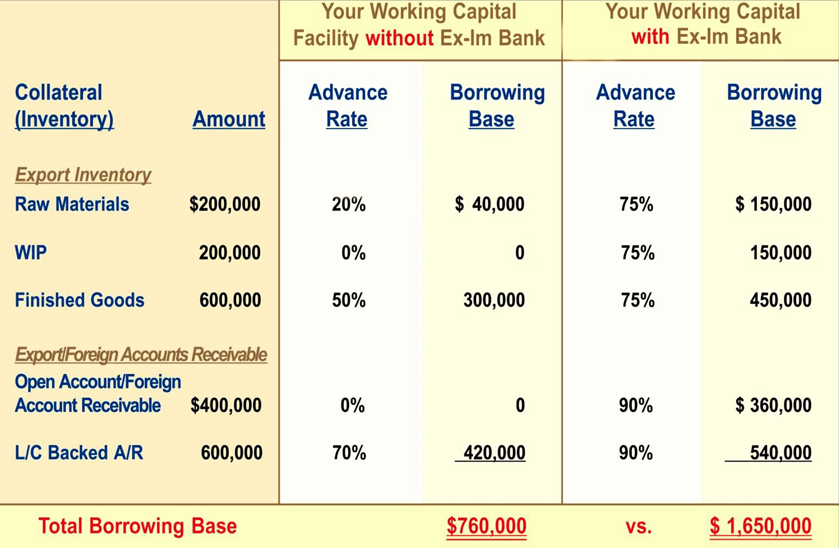





With Ex-Im Guarantee
Exporter Accounts
+$890,000

Slide 11
Success Story: Boiler {indirect}
Challenge:
  Small business, High end fabrication shop, Garland,
  Indirect, export opportunity for Bechtel – to China.
Solution:
  Company received a working capital loan facility backed by an Ex-Im Bank working capital guarantee to support raw material/s procurement.
  One off – non DA
Result:
  Win/Win ~ Exporter / Lender!
Notes:
Mr. Kemp – Your ExIm Bank backed loan program has allowed xyz to fabricate and export millions of dollars to qualified foreign countries – 90%~ to China. We actually had a significant record year ending 12/09. This due mainly to the export business.
Regions Bank ExIm program works efficiently, seamlessly and with less red-tape than any other banking relationship I have ever experienced. Except for the annual loan review and renewal, we work on line directly with their ExIm officer in Miami. Carson Strickland has visited the shop several times as have our local officers Kevin Rudge and Bill Smith. I have also recommended the ExIm program to several other businesses. I always tell of my original phone contact with you where after asking me some basic question, including who we banked with, I was then contacted by Carson Strickland of Regions B’ham office, all within about 15 minutes. After their due diligence, we were off and running. Never had an experience like that with a Federal Government program or bank before.
We expect this area of our business to continue and to grow significantly, particularly in China (barring some political upheaval).
Thanks for you help!
Kind regards,
Huey Yaun
Precision Industries, Inc.

Slide 12
II. Short-Term Export Credit Insurance
  Do you have ‘strategic repeat buyers?’ – or,
  #800 Gorilla’s ?
Allows exporters to offer competitive credit terms to foreign buyers
  Generally up to 180 days, some products may qualify for 360 day terms
Obtain additional financing
  Insured foreign receivables may be added to your borrowing base by assignment of policy proceeds (claim payments) to lender

Slide 13
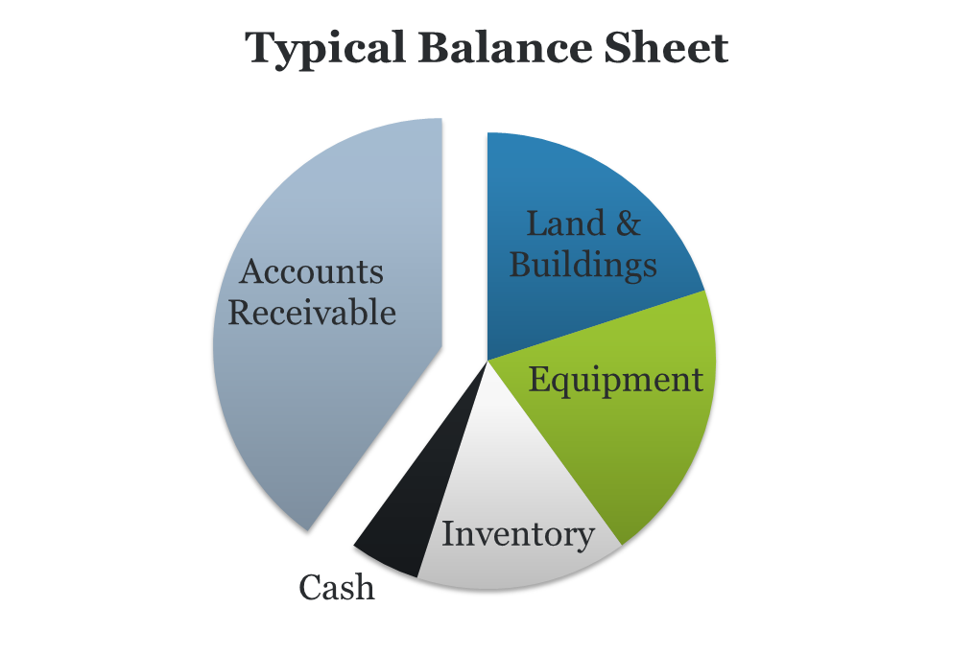
Exporter Benefits
Risk Mitigation
    Prevention of catastrophic losses to one of the company’s largest, unprotected assets
    Credit management tool
Competitiveness/Marketing
    Growth of Existing Accounts
    New Market Penetration
        Utilization of A/R as an Asset
    Borrowing against foreign receivables
    Lower borrowing costs
    Frees up working capital and accelerates cash flow
Notes:
A company’s accounts receivable are:
• Most vulnerable to unexpected losses
• Likely to be affected by business cycles
• Provides cash flow (lifeblood) for the business
Obtaining credit insurance can:
• Aid in credit risk evaluation and reduction of key account concentration levels
• Cap exposure to bad debt loss and decrease bad debt write-offs
If a company’s revolving credit line is secured by its accounts receivable, a write-off of part of those receivables immediately impacts cash flow. The same level of funds is no longer available for the company to run its day-to-day operations.
• Provide key account monitoring and back-up support and assistance to your client’s existing credit function
The exporter also benefits through extended financing opportunities. By utilizing export credit insurance, companies can borrow against foreign receivables.
Reduction in bad debt reserves frees up working capital and boosts the company’s liquidity.
It also converts non-taxable deductible provisions into a fully tax deductible insurance premium.

Slide 14













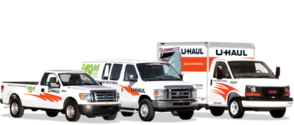










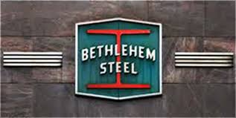












There’s A Reason Big Company’s Use It!
What do the companies below have in common?
What will also surprise you is how many small companies use it as well!

Slide 15
Short Term Export Credit Export Credit Insurance
Policies for Small Business*:
  Small Business Multi Buyer
    95 % cover, one-time $500 refundable policy issuance fee, pay-as-you-go,
    Standard Multi-Buyer
    95 % cover, one-time $500 refundable policy issuance fee, pay-as-you-go, some buyer approval authority may be given to exporter
  Single-Buyer
    90% cover, no deductible
    * SBA definition

Slide 16
Trade Credit Insurance (Short- Term)
Foreign Buyer Qualifications
Ex-Im Bank’s Short-Term Credit Standards are
available at
http://www.exim.gov/tools/credit-standards.cfm

Slide 17
Risks Covered
Commercial Risks
Insolvency
  Bankruptcy
  Protracted default
Political Risks
Transfer risk
War, revolution,
insurrection, expropriation
Cancellation of an import
or export license

Slide 18
Success Story: Combo ~ LQ
Challenge:
  Small business, manufacturer – equipment for PEMEX
Solution:
  The company used a short-term single-buyer insurance policy as a risk management measure on an exc.
Result:
  The company gained working capital support from its bank in support of this $5mm opportunity!
    Discounts…
Notes:
Buyer/obligor: PEMEX Exploracion Y Produccion SA de CV, Mexico
Broker : J Maxime Roy Inc.
Product/use: offshore living quarters
High outstanding: $4,887,900
Estimated Small Business: 100%
Terms: 30 days open account
Pemex, the stae-owned oil company is well known to EIB for many years and it is the largest borrower of EIB.
Living Quarter Technology was started in 2000 and incorporated the same year in LA. It operates as a contractor for providing offshore oil and gas accommodations. They design and construct buildings certified by the US Coast Guard, ABS, Lloyds, DNV and Homeland Security.
Website: http://www.livingquartertech.com/
JPM Chase will be funding a working capital loan to Living Quarters to support their transaction with PEMEX subject to this insurance policy

Slide 19
III. Medium-Term Insurance and Guarantees
Capital equipment sales and related services
Used equipment – can be considered
Buyer criteria per Medium-term Credit Standards
  Minimum 3 year history
  Reliable financial statements (audited if credit exceeds $1 million)
  Buyer must meet certain financial ratios

Slide 20
Standard Finance Model
Single shipment ~ 5 year ~ private-sector Mexico
Net Contract Price: US $1,000,000
Less: 15% Down payment: 150,000
Financed Portion: 850,000
Plus: Ex-Im Exposure Fee: 31,280 (3.68%)
Total Financed Amount: $881,280
Payable in 10 equal semi-annual principal payments of $88,128 plus accrued interest.
Pricing Indication:
  Lender’s interest rate: 6-mo. Libor + __%
  Lender’s facility fee: 1-2%
  Ex-Im Commitment Fee: 0.125% (if “Guarantee”)

Slide 21

Success Story: Air Tractor Inc.
Air Tractor uses Ex-Im Bank’s medium-term insurance to export its agricultural aircraft
such as this AT402 to developing markets in Latin America.

Slide 22
Kelly Kemp
Regional Director NTX
1700 N. Redbud Blvd.
McKinney, TX 75069
kelly.kemp@exim.gov
iPhone: 214-551-4959
www.exim.gov
1-800-565-3946 (EXIM)
©2015 Export-Import Bank of the United States

